Slide 1
MRA Project - Milestone 2 Market basket Analysis
Vivek Bhatia
PGPDSBA_ONLINE_JAN_C_2022

Slide 2
Executive Summary
The project aims to identify the most popular combos that can be suggested to a grocery store after a through analysis of menu items in the customer order.
To suggest best combo meals as the store does not have a combo meal

Slide 3
Contents
Exploratory Analysis of data
Trends across months/years/quarters/days
Market Basket Analysis & Association Rules
Conclusions

Slide 4
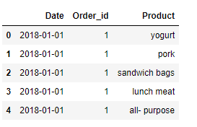
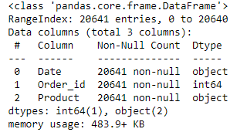

Exploratory data analysis
Sample of the data set
The data consists of 20641 rows and 3 columns.
There are 4370 duplicate values.
Data set Info
Data Description

Slide 5
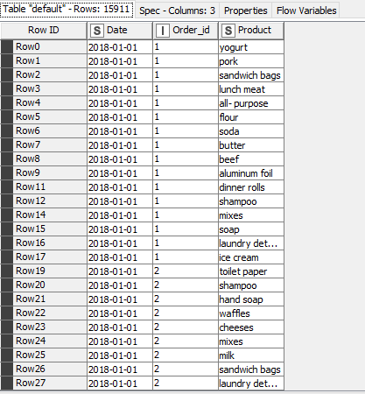
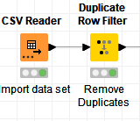
Exploratory data analysis
Duplicate data filtered and number of rows is 15911

Slide 6
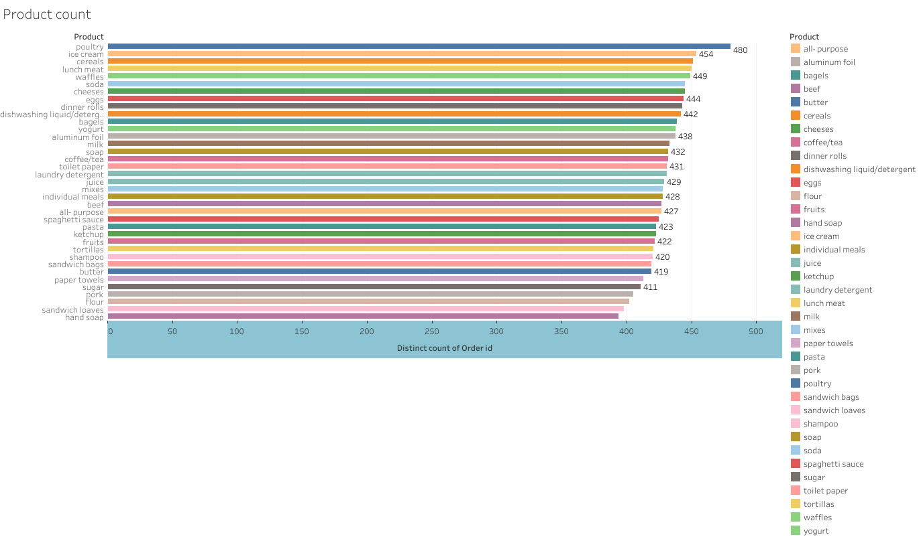
Exploratory data analysis-Tableau
The poultry has maximum count of 480 followed by ice cream having a count of 454. Least count is 394 of hand soap.

Slide 7
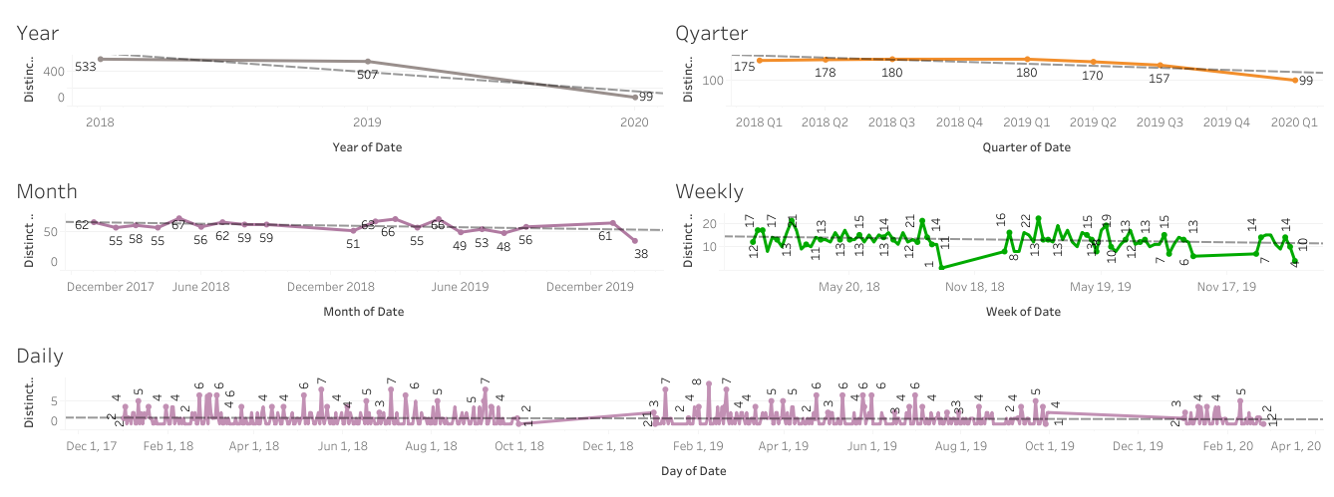
Exploratory data analysis-Tableau

Slide 8
Exploratory data analysis-Conclusions
There is continuous decline in order count YOY.
We can see a moderate but definite downwards trend in year, quarterly, monthly , weekly and daily plot of order qty.
The downwards trend signifies decline in business.

Slide 9

Market basket analysis
Market basket Analysis is a technique used by large retailers to uncover the associations between items.
It looks for combinations of items that occur together frequently.
Market basket Analysis is mathematical based on primality and conditional probability.
The fundamental question is what is the probability of a customer buying a Product ‘X’ given that the customer has picked up/purchased set ‘A’.
This technique helps in giving recommendations with high probabilities of recommended items being chosen and thus leading to increase in sales.

Slide 10
Market basket analysis
Model explanation:
Let I = {I1, I2,…, Im} be an itemset. Let D, the data, be a set of database transactions where each transaction T is a nonempty itemset such that T ⊆ I. Each transaction is associated with an identifier, called a TID(or Tid). Let A Be a set of items(itemset). T Is the transaction which is said to contain A if A ⊆ T. An association rule is an implication of the form A ⇒ B, where A ⊂ I, B ⊂ I, and A ∩B = φ.
The rule A ⇒ B Holds in the data set(transactions) D with supports, where ‘s’ is the percentage of transactions in D that contain A ∪ B (That is the union of set A and set B, or, both A and B). This is taken as the probability, P(A ∪ B). Rule A ⇒ B has confidence c in the transaction set D, where C is the percentage of transactions in D containing A that also contains B. This is taken to be the conditional probability, like P(B|A). That is,
support(A⇒ B) =P(A ∪ B)
confidence(A⇒ B) =P(B|A)
Rules that satisfy both a minimum support threshold (called min sup) and a minimum confidence threshold (called min conf ) are called “strong”.

Slide 11
Market basket analysis
Mathematical Representation
Confidence(A⇒ B) = P(B|A) = support(A ∪ B) /support(A) = support count(A ∪ B) / support count(A)
An Example Of Association Rules:-
Assume There Are 1000 Customers
100 Of Them Bought Shampoo, 80 Bought Conditioner And 60 Bought Both Of Them.
Bought Shampoo => Bought Conditioner
Support = P(Shampoo & Conditioner) = 60/1000 = 0.06
Confidence = Support/P(Conditioner) = 0.06/0.08 = 0.75
Lift = Confidence/P(Shampoo) = 0.75/0.10 = 7.5

Slide 12
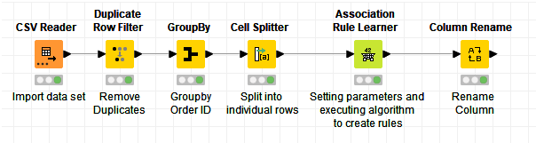
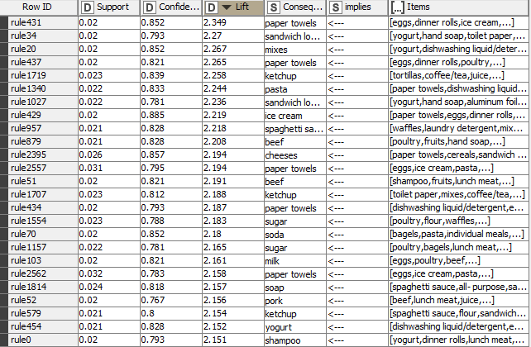
Market basket analysis-KNIME Workflow
Support is the probability of two products occurring in a set, i.e. Support=P(A and B)
Confidence is the conditional probability.
Confidence=Support/P(B)
Lift is Confidence/Probability of first item in the set.
Lift=Confidence/P(A).
For association rule learner minimum support of 0.2 and minimum confidence of 0.7 was used as defining parameters.

Slide 13
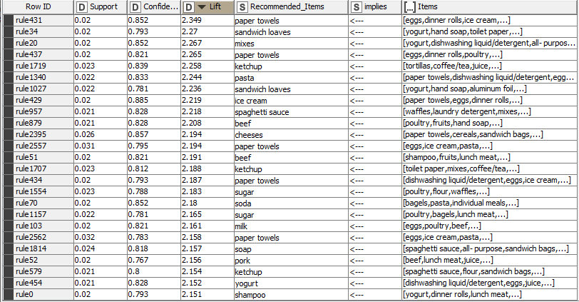
Market basket analysis-Conclusion
For each rule we have a recommended item.
For e.g.: Customer having eggs, dinner rolls , ice cream can opt for paper towel and it has a confidence level of 0.852.

Slide 14
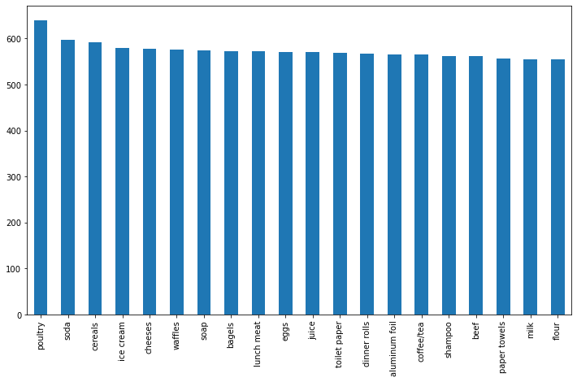
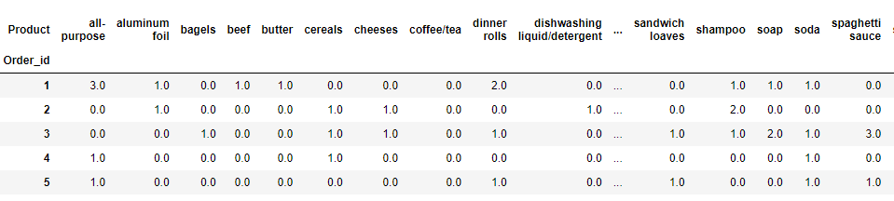
Market basket analysis-python analysis Dashboard

Slide 15
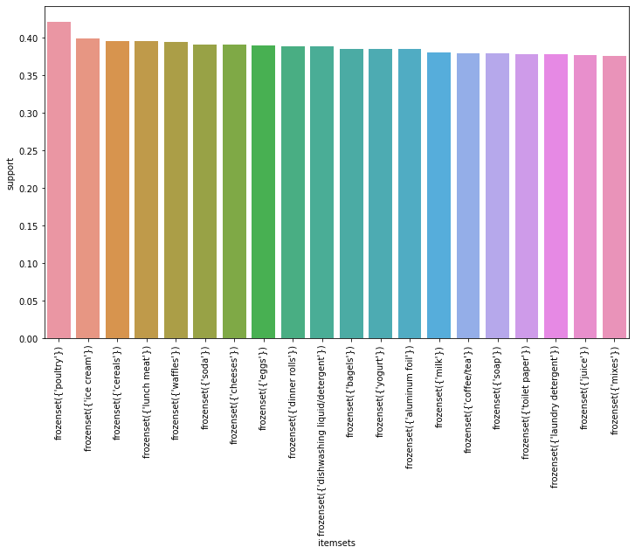
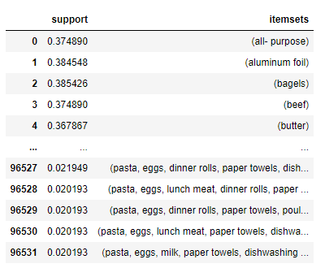
Market basket analysis-python analysis Dashboard

Slide 16
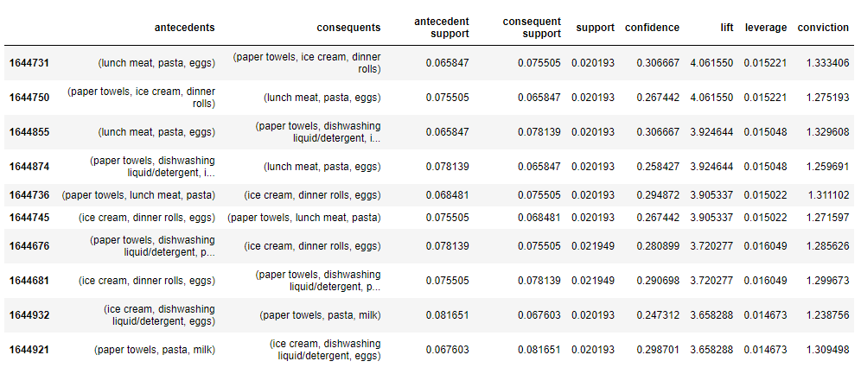
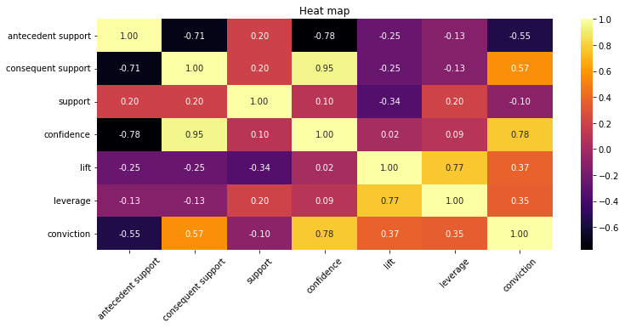
Market basket analysis-python analysis Dashboard

Slide 17
Market basket analysis-conclusions
Antecedent support, consequent support and confidence have high correlation and hence will complement each other.
The store can provide combo offers for lunch meat, pasta, eggs with paper towels, ice cream, dinner rolls.
Alternatively, with Ice cream and eggs , milk and pasta can be combined.
Care should be taken to look into confidence while preparing the combo meal offers.
Offers can be packaged as below:
With lunch meat and eggs get a complementary ice cream or dinner rolls at 50% discount.
2. With eggs get 5% discount on milk
3. With Pasta get 10% off on eggs

